Slide 1
BMI Estimation using facial features
G. PULLAIAH COLLEGE OF ENGINEERING AND TECHNOLOGY
Department of Computer Science and Engineering
IV – B.Tech II SEMESTER
Final Project Review
Project Title
B. Somanaidu ( 19AT1A05E3 ) Project Supervisor K. Sreenu (19AT1A05F2 ) Mr . D.JAYANARAYANA REDDYM.Tech.,(Ph.D) G. Srivathsa ( 19AT1A05F8 ) Associate Professor K. Umesh Chandra Reddy ( 19AT1A05G9 ) Department Of CSE

Slide 2
OUTLINE
ABSTRACT
INTRODUCTION
LITERATURE SURVEY
PROPOSED SYSTEM
MODULES
SYTEM ARCHITECTURE
UML DIAGRAMS
RESULTS
CONCLUSION

Slide 3
ABSTRACT
Body Mass Index (BMI) is a measure of how healthy a person is with respect to their body weight. BMI has shown a correlation with various factors like physical health, mental health, popularity. BMI calculation often requires accurate height and weight, which would take manual work to measure.
Largescale automation of BMI calculation can be utilized for analyzing various aspects of society and can be used by governments and companies to make effective decisions. Previous works have used only geometric facial features discarding other information, or a data-driven deep learning-based approach in which the amount of data becomes a bottleneck.
In this project we are using python CNN (convolution neural networks) algorithm to predict BMI by analyzing facial features. CNN will take image as input and then extract facial features from image and based on facial features BMI will be predicted.

Slide 4
INTRODUCTION
The BMI(Body Mass Index) of any person is a crucial indicator of health. It checks if the person is underweight, normal, overweight, or obese. In the current scenario, health is one of the most neglected factor. Technology which has more benefits also has some drawbacks. It has made humans lazy and thus reduced their physical activity leading to a sedentary lifestyle and a rise in BMI which adversely affects their health and increases the risk of chronic diseases.
The more the BMI, the more is the chance of developing cardiovascular and other harmful diseases. On the other side of the coin, some people have problems like malnutrition and deficiencies. So, BMI can help a person to keep a track record of their health. According to [1], on average, one out of every three adults is overweight, which is about 36% of the population, and by the year 2030, an estimated 20% of the global population would be obese.

Slide 5
LITERATURE SURVEY
Face-to-BMI: Using Computer Vision to Infer Body Mass Index on Social Media
https://www.researchgate.net/publication/314433619_Face-to-BMI_Using_Computer_Vision_to_Infer_Body_Mass_Index_on_Social_Media
A person’s weight status can have profound implications on their life, ranging from mental health, to longevity, to ﬁnancial income. At the societal level, “fat shaming” and other forms of “sizeism” are a growing concern, while increasing obesity rates are linked to ever raising healthcare costs.
For these reasons, researchers from a variety of backgrounds are interested in studying obesity from all angles.

Slide 6
Facial Image Analysis for Body Mass Index, Makeup and Identity https://researchrepository.wvu.edu/cgi/viewcontent.cgi?article=7979&context=etd ABSTRACT: The principal aim of facial image analysis in computer vision is to extract valuable information (e.g., age, gender, ethnicity, and identity) by interpreting perceived electronic signals from face images. In this dissertation, we develop facial image analysis systems for body mass index (BMI) prediction, makeup detection, as well as facial identity with makeup changes and BMI variations. BMI is a commonly used measure of body fatness.
LITERATURE SURVEY

Slide 7
BMI Prediction From Face Images. https://www.researchgate.net/publication/335364971_BMI_Prediction_From_Face_Images ABSTRACT: Body-mass index (BMI) is the amount of mass per area of a person, and it is an important indicator of the weight status. From health industry till the social media applications, there are many areas where BMI data is used. Various machine learning techniques are developed for BMI prediction only from a face image without any information about the weight and height of a person.Making this kind of predictions is a regression problem.
LITERATURE SURVEY

Slide 8
LITERATURE SURVEY
A Framework for Healthcare Everywhere: BMI Prediction Using Kinect and Data Mining Techniques on Mobiles
https://www.researchgate.net/publication/308817784_A_Framework_for_Healthcare_Everywhere_BMI_Prediction_Using_Kinect_and_Data_Mining_Techniques_on_Mobiles
ABSTRACT: Recently, health-care has become a popular issue. Having a good physique is also commonly regarded as important for being healthy. For evaluating our body status, the Body Mass Index (BMI) is a widely used indicator.
However, calculating BMI is inconvenient and requires the physical measuring of people&#39;s weights and heights. In this paper, we are interested in building a mobile-based BMI prediction system using Kinect and data mining techniques so that everybody can easily monitor their BMI everywhere by taking a snapshot of their face.

Slide 9
EXISTING SYSTEM
A person's body mass index (BMI) is a gauge of how healthy they are in relation to their weight. Numerous aspects, including physical health, mental health, and popularity, have been linked to BMI. BMI calculations frequently call for precise measurements of height and weight, which entail labor-intensive manual labor.
Governments and businesses can employ large-scale automation of BMI calculation to analyze different facets of society and to make smart decisions. Previous approaches have exclusively employed geometric facial traits, disregarding additional information, or have used a data-driven deep learning approach where the volume of data becomes a difficult.
DISADVANTAGES OF EXISTING SYSTEM:
the volume of data becomes a difficult
Recently there have been many advancements in deep learning where models can extract meaningful features from the images but can’t predict BMI

Slide 10
PROPOSED SYSTEM
In this project, we're analyzing facial features to estimate BMI using the Python CNN (convolution neural networks) algorithm.
CNN will use a picture as its input, extracting facial traits from it before predicting BMI based on those features.
Advantages of proposed system:
Far preprocessing for best prediction
High prediction rate

Slide 11
REQUIRMENTS
HARDWARE REQUIREMENTS
Minimum hardware requirements are very dependent on the particular software being developed by a given Enthought Python / Canopy / VS Code user.
Applications that need to store large arrays/objects in memory will require more RAM, whereas applications that need to perform numerous calculations or tasks more quickly will require a faster processor.
Operating system : windows, linux
Processor : minimum intel i3
Ram : minimum 4 gb
Hard disk : minimum 250gb

Slide 12
ALGORITHMS
CNN:
A Convolutional Neural Network (ConvNet/CNN) is a Deep Learning algorithm which can take in an input image, assign importance (learnable weights and biases) to various aspects/objects in the image and be able to differentiate one from the other. The pre-processing required in a ConvNet is much lower as compared to other classification algorithms. While in primitive methods filters are hand-engineered, with enough training, ConvNets have the ability to learn these filters/characteristics. The architecture of a ConvNet is analogous to that of the connectivity pattern of Neurons in the Human Brain and was inspired by the organization of the Visual Cortex. Individual neurons respond to stimuli only in a restricted region of the visual field known as the Receptive Field. A collection of such fields overlap to cover the entire visual area.

Slide 13
MODULES
In this project we are using python CNN (convolution neural networks) algorithm to predict BMI by analysing facial features. CNN will take image as input and then extract facial features from image and based on facial features BMI will be predicted. To implement this project we have designed following modules.
Generate & Load BMI & Face Detection Models: Using this module we will load facial detection CV2library and BMI detection CNN model. Facial detection library help us to detect human face from uploaded image and then facial features will input to CNN model to predict BMI
Upload Image: using this module we will upload image to application
Run Face & BMI Detection Algorithm: This model extract face from given input image and then facial features will be analyse to predict BMI. Based on predicted BMI insurance policy will be quoted to users.

Slide 14
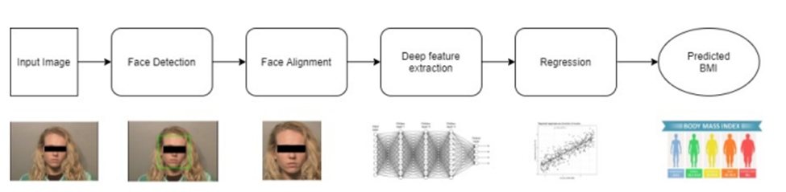
SYSTEM ARCHITECTURE

Slide 15
UML DIAGRAMS

Slide 16
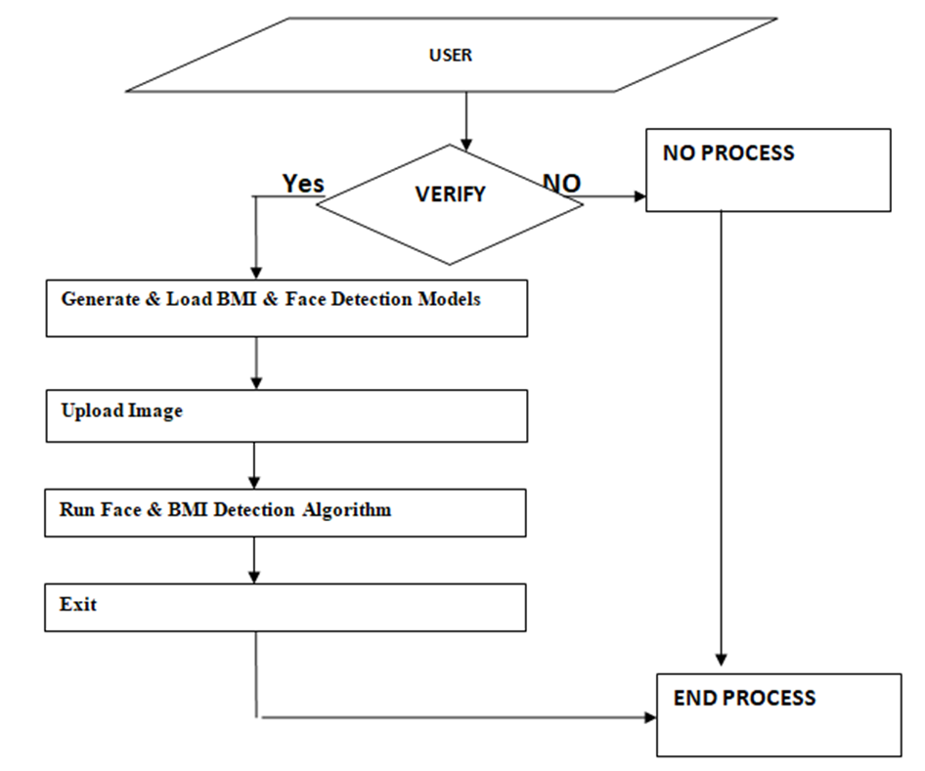
DATA FLOW DIAGRAM

Slide 17
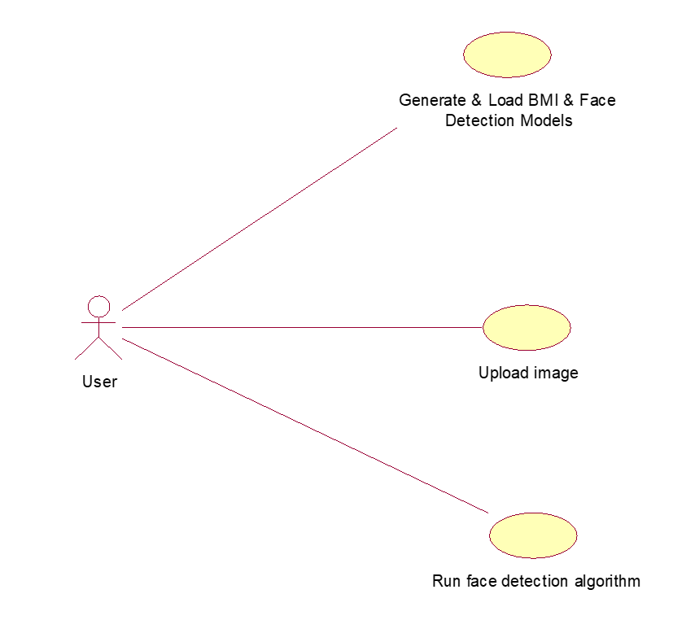
USE CASE DIAGRAM

Slide 18
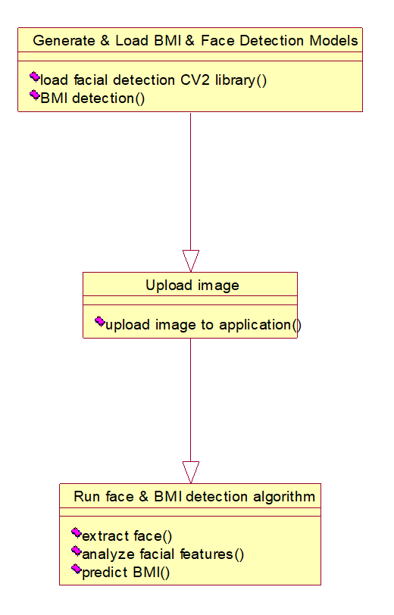
CLASS DIAGRAM

Slide 19
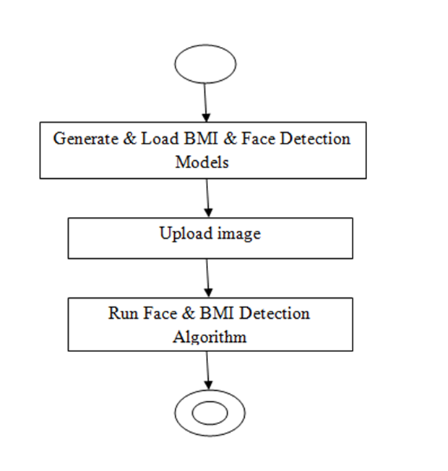
ACTIVITY DIAGRAM

Slide 20
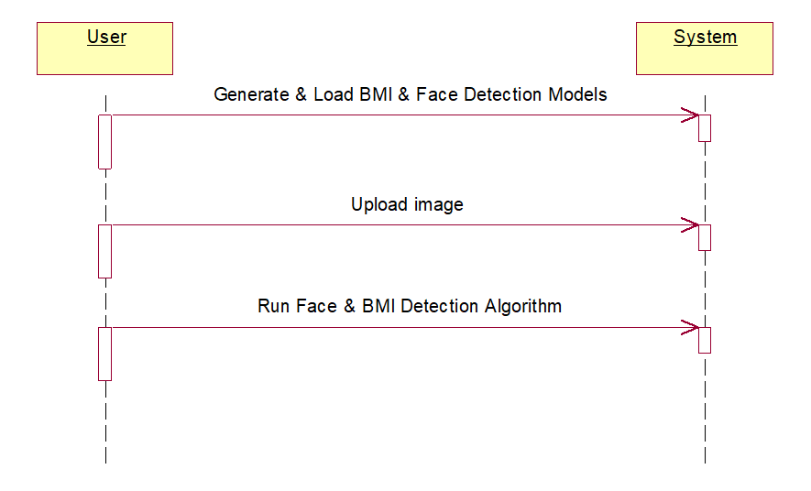
SEQUENCE DIAGRAM

Slide 21
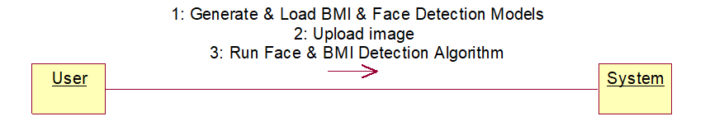
COLLABORATION DIAGRAM

Slide 22
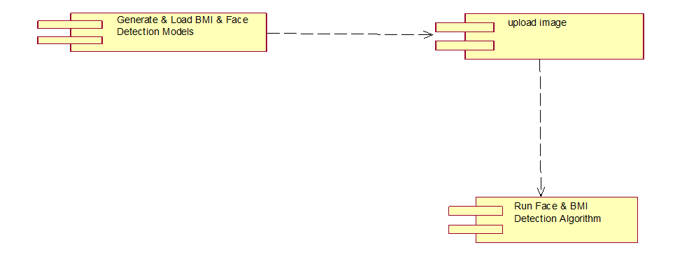
COMPONENT DIAGRAM

Slide 23
RESULTS

Slide 24
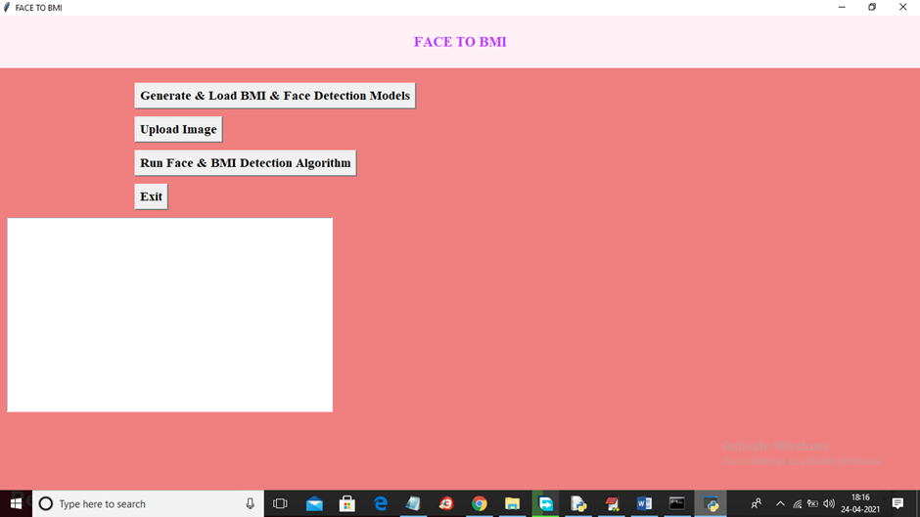

Slide 25
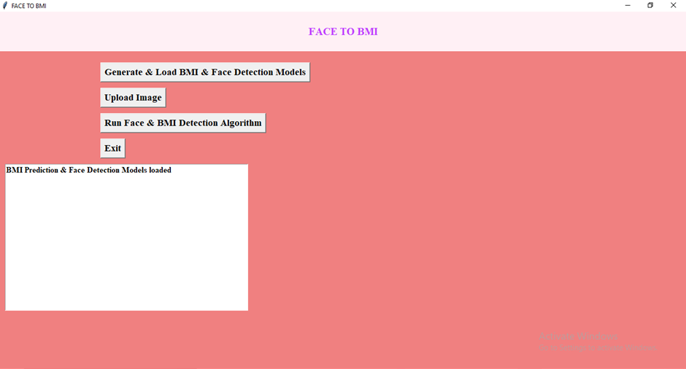

Slide 26


Slide 27


Slide 28
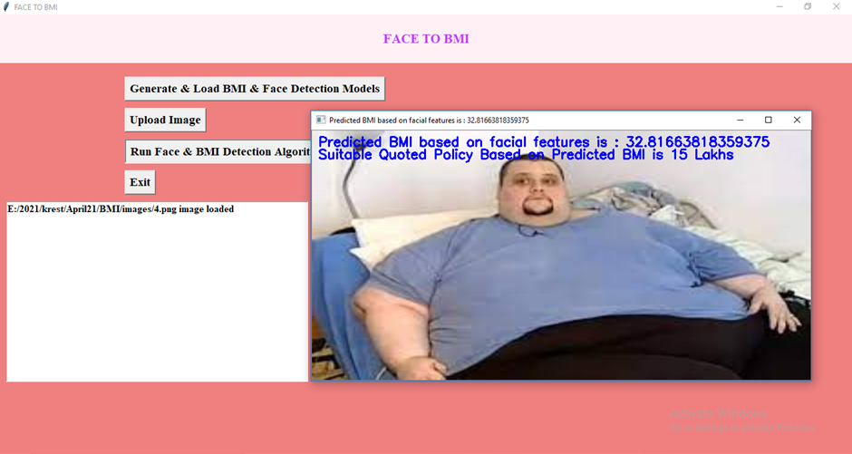

Slide 29
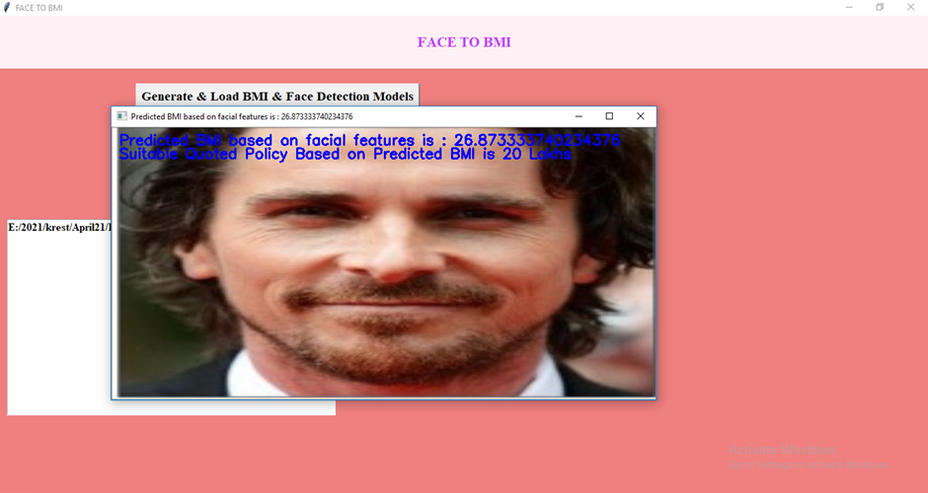

Slide 30
CONCLUSION
We observed that people with more BMI have a higher risk of developing health issues. We found that there exists a strong association between BMI and the face of a human. So, we proposed an approach to predict BMI from facial images using deep learning. We preprocessed the facial data by aligning the faces to the center using the BMI detection algorithm.
In future work, we will apply our method to social media proﬁle pictures to model population-level obesity rates. Preliminary results show that both regional and demographic differences in BMI are reﬂected in large amounts of Instagram proﬁle pictures.

Slide 31
REFERENCES
1. [Girshick and others 2014] Girshick, R., et al. 2014. Richfeature hierarchies for accurate object detection and seman-tic segmentation. In CVPR, 580–587.
2. [Guntuku and others 2015] Guntuku, S. C., et al. 2015. Doothers perceive you as you want them to?: Modeling person-ality based on selﬁes. In ASM, 21–26.
3. [Henderson and others 2016] Henderson, A. J., et al. 2016.Perception of health from facial cues. Philosophical Trans-actions of the Royal Society of London B: Biological Sci-ences 371(1693).
4. [Krizhevsky and others 2012] Krizhevsky, A., et al. 2012.Imagenet classiﬁcation with deep convolutional neural net-works. In NIPS, 1097–1105.
5. [Little and Perrett 2007] Little, A. C., and Perrett, D. I. 2007.Using composite images to assess accuracy in personality at-tribution to faces. British Journal of Psychology 98(1):111–126.

